Slide 1

Algebra 1
Unit 3, Lesson 8 Analyzing Residuals Volume 1, pg. 150

Slide 2


Benchmark
MA.912.DP.2.6
Given a scatter plot with a line of fit and residuals, determine the strength and direction of the correlation. Interpret strength and direction within a real-world context.
volume 1, pg. 150

Slide 3
Integrated Mathematical Thinking and Reasoning Standards
MA.K12.MTR.1.1 Actively participate in effortful learning both individually and collectively.
MA.K12.MTR.2.1 Demonstrate understanding by representing problems in multiple ways.
MA.K12.MTR.4.1 Engage in discussions that reflect on the mathematical thinking of self and others.
MA.K12.MTR.5.1 Use patterns and structure to help understand and connect mathematical concepts.
MA.K12.MTR.6.1 Assess the reasonableness of solutions.
MA.K12.MTR.7.1 Apply mathematics to real-world contexts.
volume 1, pg. 150

Slide 4

Learning Targets
I can determine whether a function is an appropriate fit for the data by analyzing residuals.
I can interpret the strength and direction of the correlation within a real-world context.
volume 1, pg. 150

Slide 5

Warm-Up
volume 1, pg. 150

Slide 6
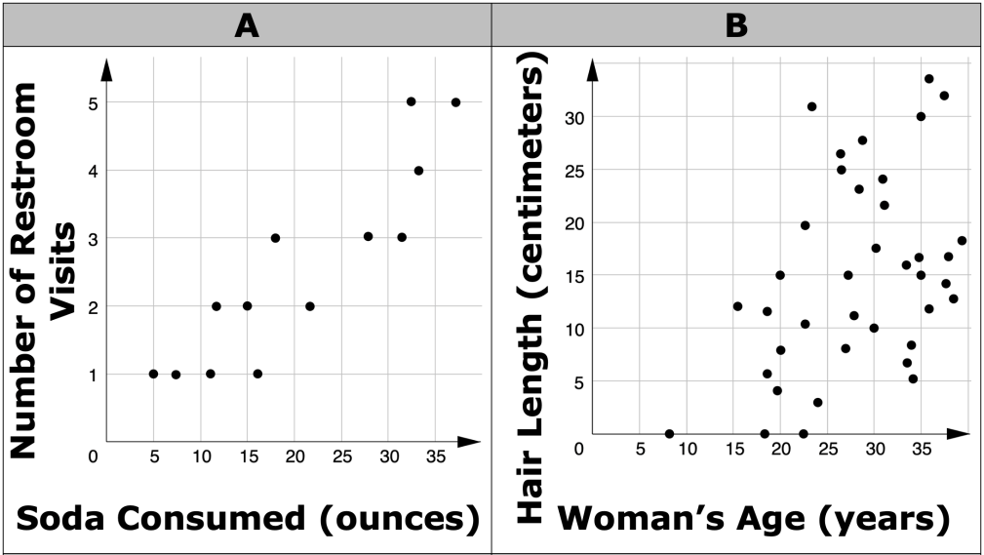
3.8.1 Warm-Up: Bell Work
Four scatter plots are shown.
volume 1, pg. 150
Notes:
Video Link: https://algebranation.wistia.com/medias/fi4fidi5y8

Slide 7
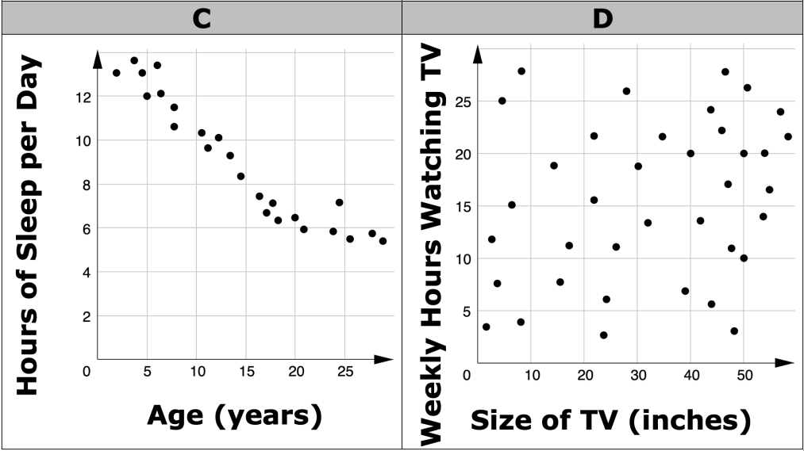
Order the scatter plots from bivariate data that is “least closely fit to a line” to “most closely fit to a line” by writing the letter corresponding to each graph.
Least Closely Fit to a Line |  |  |  | Most Closely Fit to a Line
volume 1, pg. 150
Notes:
Video Link: https://algebranation.wistia.com/medias/fi4fidi5y8

Slide 8

Exploration
volume 1, pg. 151

Slide 9
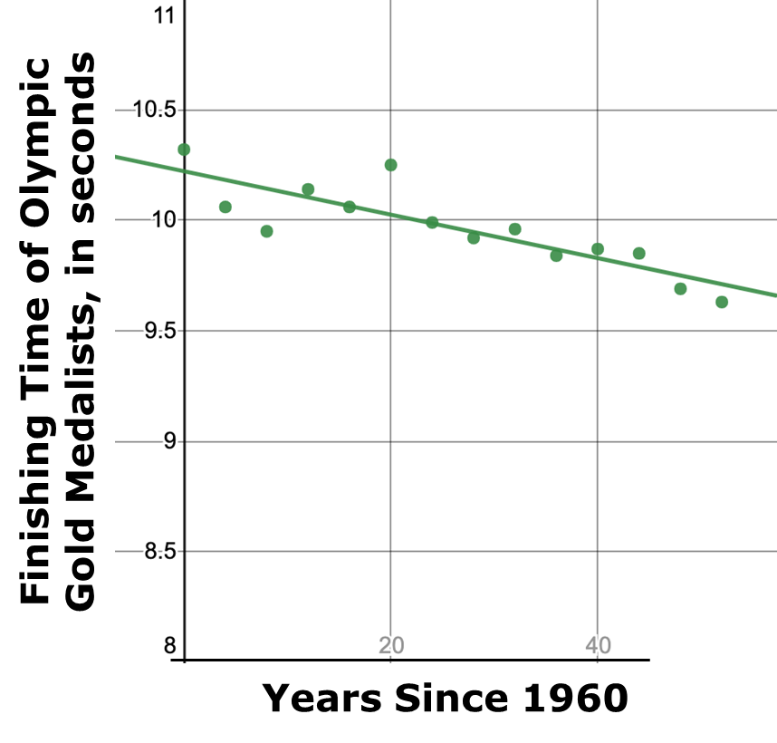
3.8.2 Exploration: Predicted vs. Actual Values
The scatter plot below shows the finishing times for the Olympic gold medalist in the men's 100-meter (m) dash for the Olympic games since 1960.
volume 1, pg. 151

Slide 10
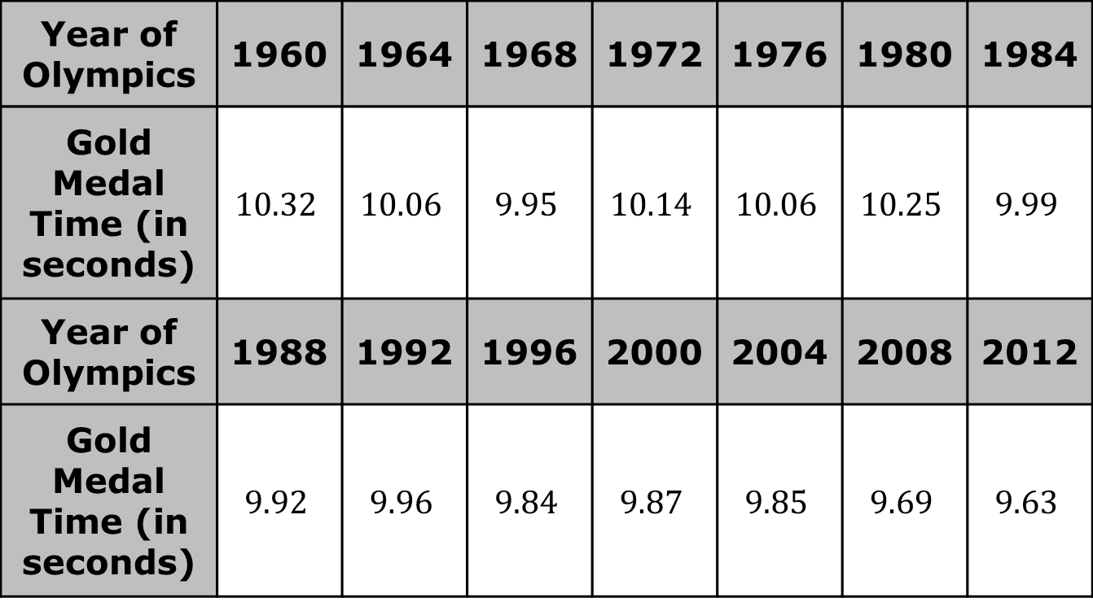
The raw data used to construct the scatter plot is shown.
Year of Olympics | 1960 | 1964 | 1968 | 1972 | 1976 | 1980 | 1984
Gold Medal Time (in seconds) | $$10.32$$ | $$10.06$$ | $$9.95$$ | $$10.14$$ | $$10.06$$ | $$10.25$$ | $$9.99$$
Year of Olympics | 1988 | 1992 | 1996 | 2000 | 2004 | 2008 | 2012
Gold Medal Time (in seconds) | $$9.92$$ | $$9.96$$ | $$9.84$$ | $$9.87$$ | $$9.85$$ | $$9.69$$ | $$9.63$$
volume 1, pg. 151

Slide 11
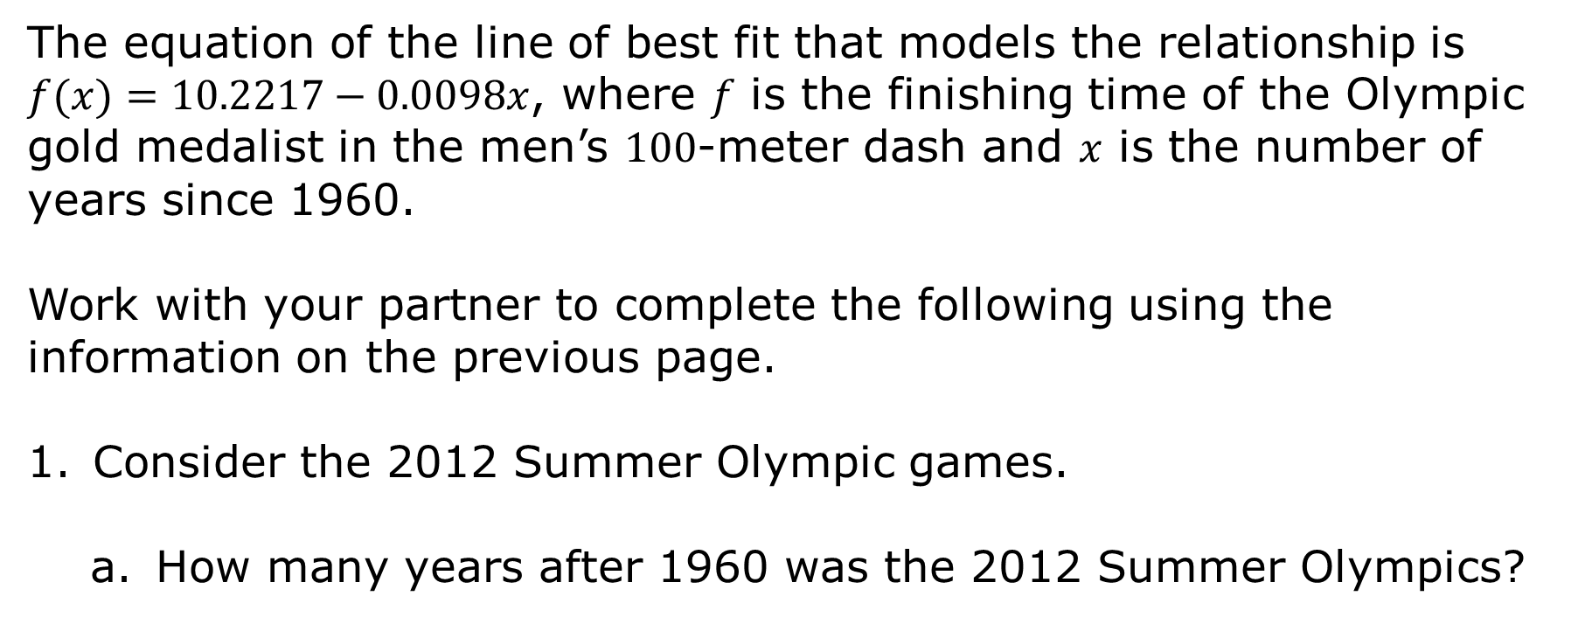
The equation of the line of best fit that models the relationship is $f(x)=10.2217−0.0098x$, where 𝑓 is the finishing time of the Olympic gold medalist in the men’s $100$-meter dash and 𝑥 is the number of years since 1960.
Work with your partner to complete the following using the information on the previous page.
Consider the 2012 Summer Olympic games.
How many years after 1960 was the 2012 Summer Olympics?
volume 1, pg. 151

Slide 12
Using the equation that models the relationship between years since 1960 and the Olympic gold medal finishing times, what is the predicted finishing time for the men’s gold medalist in 2012, rounded to the nearest hundredth?
What was the actual finishing time for the men’s gold medalist in 2012?
volume 1, pg. 151

Slide 13
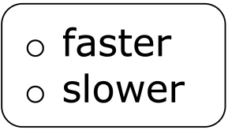
Complete the statement using your answers from Parts B and C.
The actual finishing time for the men’s gold medalist in the 2012 Summer Olympics was than predicted using the line of best fit by __________ seconds.
volume 1, pg. 151

Slide 14
Identify one point on the scatter plot where the actual finishing time for the gold medalist was more than the model predicted.
Find the coordinates of the point.
Explain how you know the actual finishing time was more than the model predicted.
volume 1, pg. 152

Slide 15
Discuss with your partner whether the linear function appears to be a good fit for the data and how you know. Summarize your discussion.
volume 1, pg. 152

Slide 16

Guided Instruction
volume 1, pg. 152

Slide 17

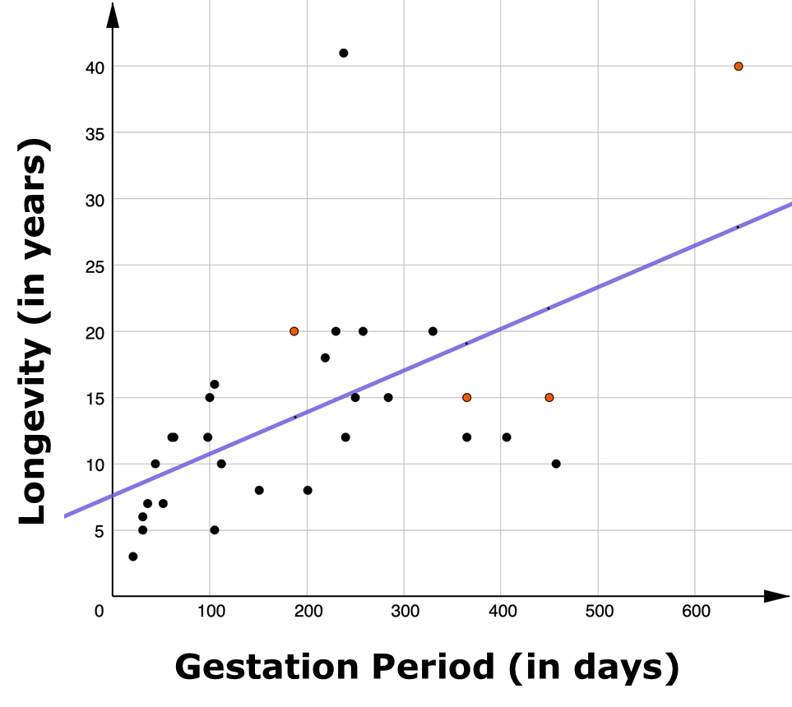
3.8.3 Guided Instruction: Analyzing Residuals
The scatter plot summarizes the average gestation period, in days, and average longevity, in years, for a sample of 30 animals as reported in The World Almanac and Book of Facts (McGeveran, 2006). A gestation period is the amount of time for which an animal is pregnant. Longevity refers to how long an animal lives.
volume 1, pg. 152

Slide 18

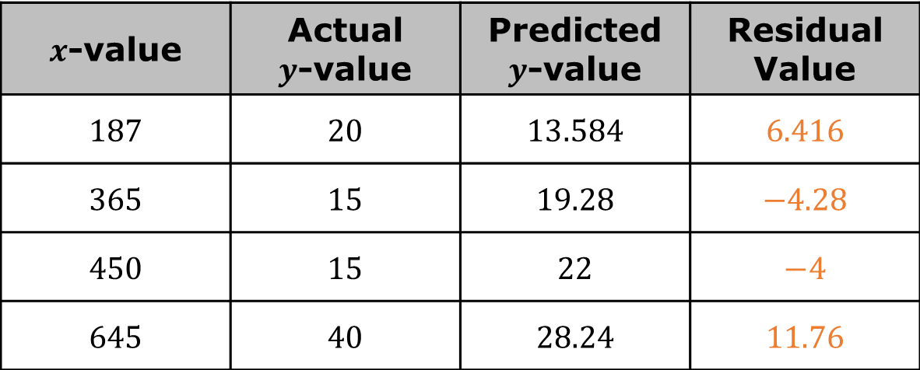
The function $g(x)=0.032x+7.6$ is fit to the data.
Consider the table shown with the $x$-values, actual $y$-values, predicted $y$-values, and residual values of the orange points on the scatter plot.
Discuss with your partner what you think a residual value is.
$x$-value | Actual $y$-value | Predicted $y$-value | Residual Value
$$187$$ | $$20$$ | $$13.584$$ | $$6.416$$
$$365$$ | $$15$$ | $$19.28$$ | $$−4.28$$
$$450$$ | $$15$$ | $$22$$ | $$−4$$
$$645$$ | $$40$$ | $$28.24$$ | $$11.76$$
volume 1, pg. 152

Slide 19
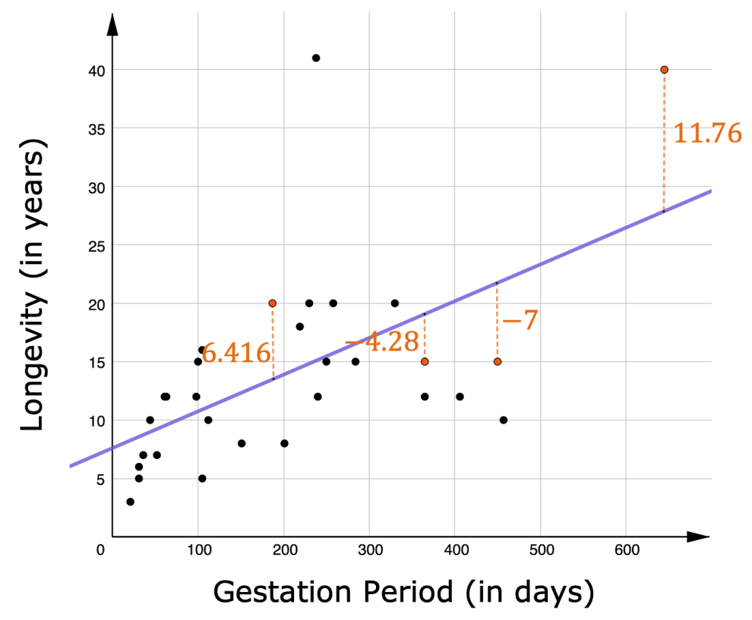
The scatter plot is shown, with the residual values of the four points from the table labeled.
volume 1, pg. 153

Slide 20
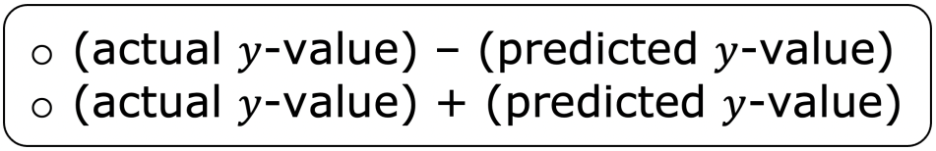
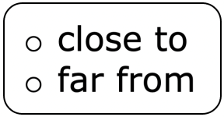
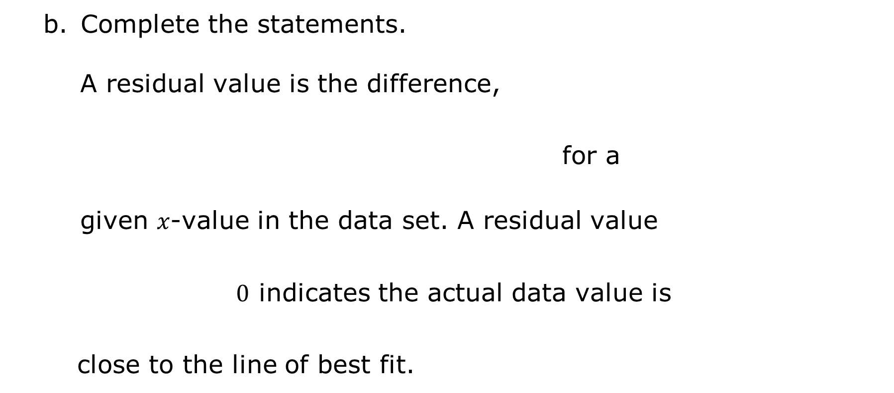
Complete the statements.
A residual value is the difference,
for a
given 𝑥-value in the data set. A residual value
$0$ indicates the actual data value is
close to the line of best fit.
volume 1, pg. 153

Slide 21
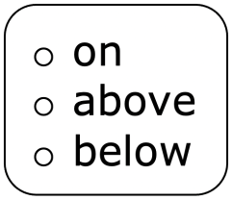


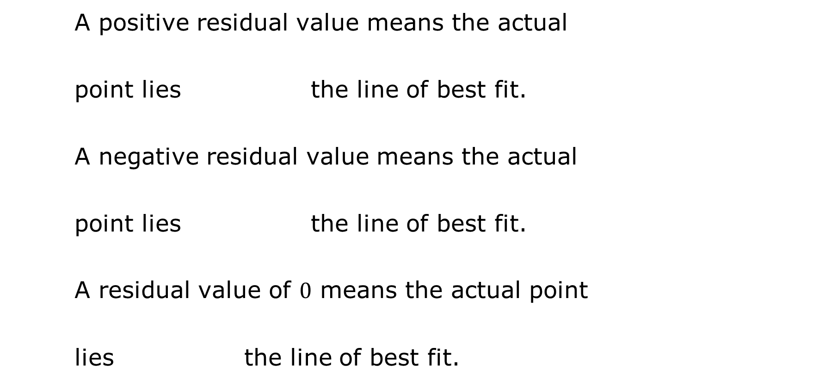
A positive residual value means the actual
point lies the line of best fit.
A negative residual value means the actual
point lies the line of best fit.
A residual value of $0$ means the actual point
lies the line of best fit.
volume 1, pg. 153

Slide 22
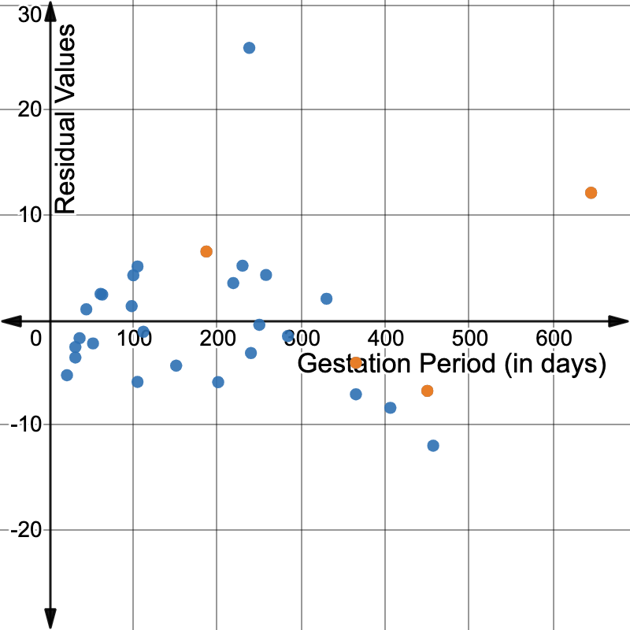
Residuals are used to analyze the strength of a line’s fit to the data. They can be represented on a residual plot like the one shown below.
Each point on the residual plot shown shows the residual value for a corresponding point on the scatter plot. The residual values explored in Problem 1 are shown in orange.
volume 1, pg. 153

Slide 23

Bring It Together
volume 1, pg. 154

Slide 24
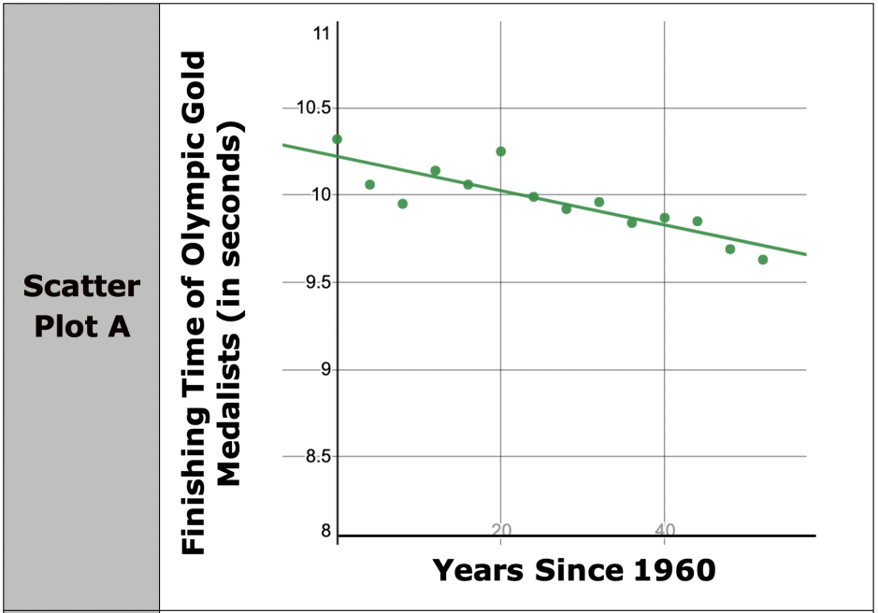
3.8.4 Bring It Together: Interpreting the Strength and Direction of a Line of Fit
The two scatter plots explored in this lesson are shown.
volume 1, pg. 154

Slide 25
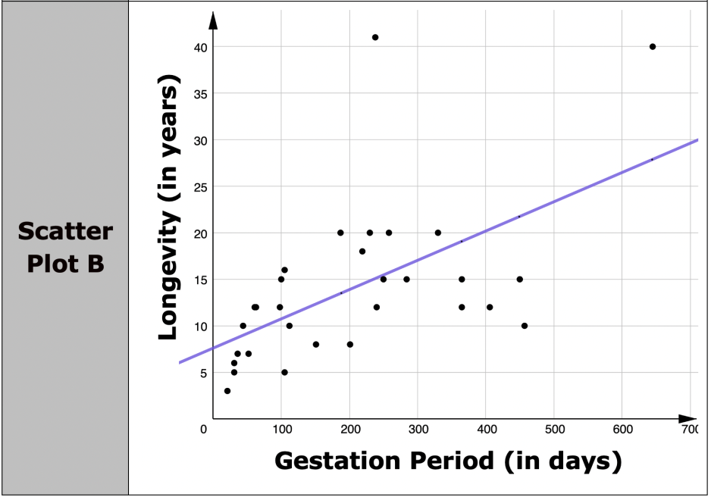
Explain which data appears to have a stronger linear association: the data represented on scatter plot A or scatter plot B?
volume 1, pg. 154

Slide 26
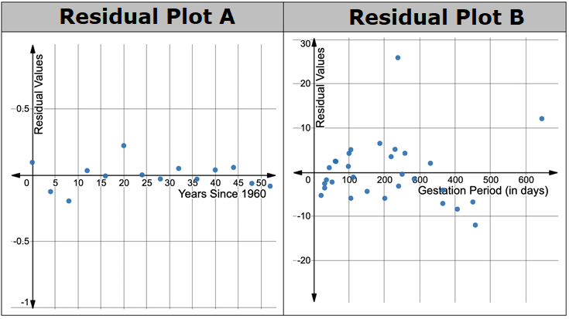
The residual plots for both scatter plots are shown.
Explain how the residual values shown on the residual plots above support your answer to Problem 1.
volume 1, pg. 154

Slide 27
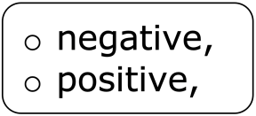
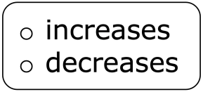
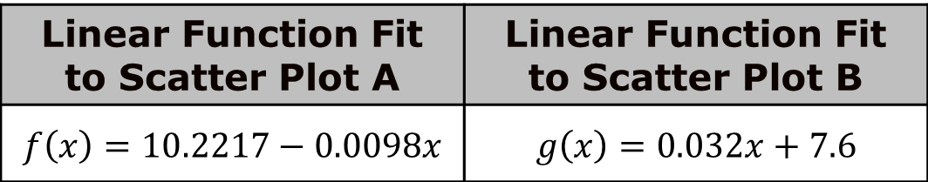
The linear functions fit to each set of data are shown.
Complete the statements.
The slope of the function fit to scatter plot A is which means the finishing time for Olympic gold medalists in the men’s 100-m dash generally
as the number of years since 1960 increases.
Linear Function Fit to Scatter Plot A | Linear Function Fit to Scatter Plot B
$$f\left(x\right)=10.2217−0.0098x$$ | $$g\left(x\right)=0.032x+7.6$$
volume 1, pg. 155

Slide 28
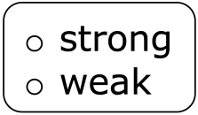
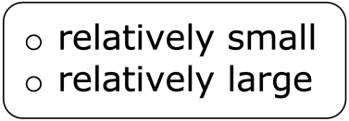
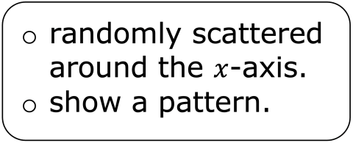

The strength of this linear relationship is because the residual
values are and The slope of the
function fit to scatter plot B is which means the longevity of an
animal´s life generally as the gestation period increases.
The strength of this linear relationship is because the residual
values are and
volume 1, pg. 155

Slide 29

Wrap-Up
volume 1, pg. 155

Slide 30
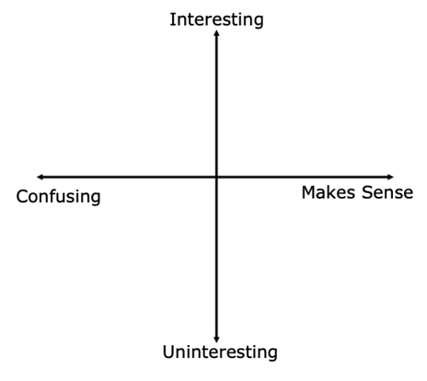
3.8.5 Wrap-Up: Reflection
Plot a point on the grid below to indicate how you feel about this lesson’s learning targets.
I can determine whether a function is an appropriate fit for the data by analyzing residuals.
I can interpret the strength and direction of the correlation within a real-world context.
volume 1, pg. 155

